Slide 1





Automate state
with
AWS State Manager
November 2023

Slide 2
What is AWS State Manager?
Part of AWS Systems Manager
Automates the process of keeping managed nodes in a defined state
Installing antivirus software on managed nodes
Joining managed nodes to an Active Directory domain
Starting of Stopping RDS instances
and more…
Multiple targeting options
Flexible scheduling options
Available at no additional cost
Notes:
AWS State Manager is a capability of Systems Manager that automates the process of keeping managed nodes or AWS resources in a defined state
By leveraging pre-configured SSM Documents, State Manager can
Bootstrap nodes with specific start-up software
Join nodes to an Active Directory domain
Start or Stop RDS instances (like what we will see)
AWS State Manager targets managed nodes, including on-prem instances, as well other AWS resources
State changes can be applied immediately or on a set frequency
Best of all, AWS State Manager is available at no additional cost

Slide 3











Getting Started
Managed nodes and AWS resources
AWS-InstallApplication
AWS-ApplyPatchBaseline
Association
AWS State Manager
AWS-CreatedDynamoDbBackup
Notes:
To get started with AWS State Manager, determine the state you want to apply to your AWS resources
> This will dictate which SSM Document to use when creating an association
> AWS-managed SSM Documents can be used or a customer managed SSM Document can be created
> Now, create a State Manager association which specifies the configuration to be assigned to the managed nodes or AWS resources
> Include the parameter for the SSM Document,
> The targets, which can be tags, instance IDs, AWS Resource Groups, or all managed nodes in a Region and Account,
> As well as the schedule describing when or how often to apply the state – this can be a cron or rate expression

Slide 4
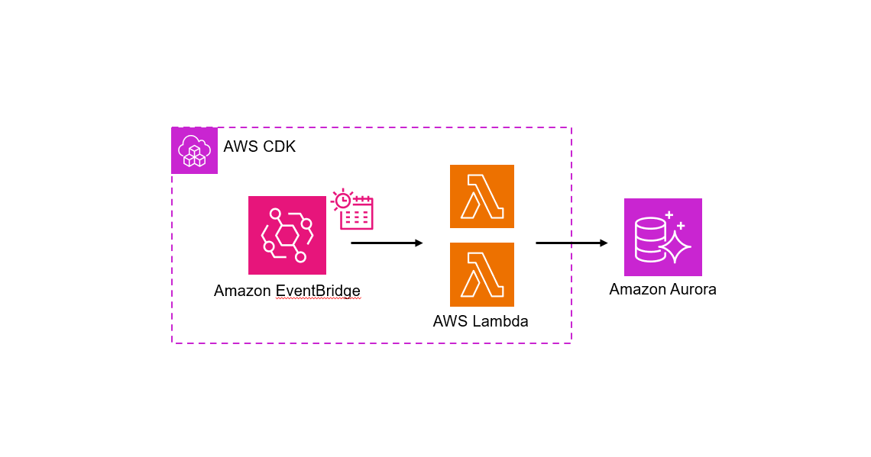
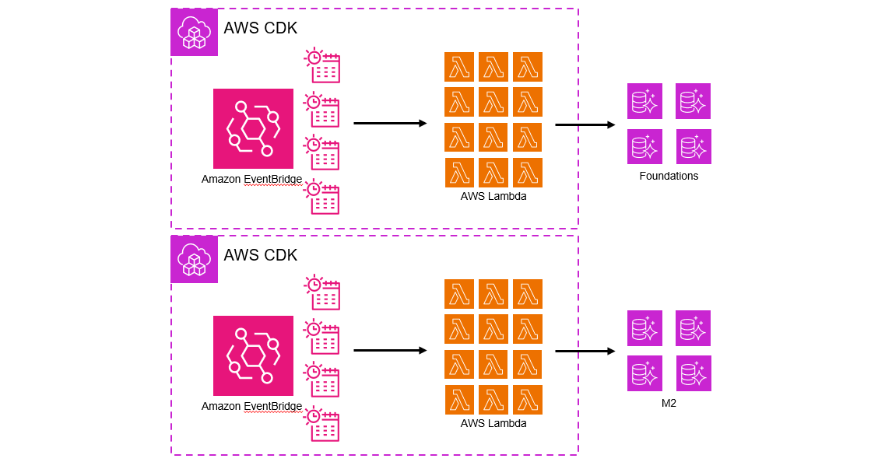

Existing Solution
56 Lambda Functions/28 EventBridge Rules
Reserved Concurrency Limit
Lambda execution costs
Per-app configuration
Automate the Start/Stop of Aurora Clusters
Notes:
> The existing solution to automate the starting and stopping of Aurora Clusters consists of an EventBridge scheduler rule and multiple Start/Stop Lambda functions containing custom code
> When we add additional applications, we duplicate this infrastructure
> And with a large team of developers, this quickly grows
> With over 56 Lambda functions and counting, this becomes an ineffective management of our account resources
Each scheduled invocation eats away at our Regional Lambda Reserved Concurrency limit
There are unnecessary cost for Lambda execution
IaC and custom code is embedded within our application
Doesn’t scale whenever a new application with an RDS cluster is added

Slide 5





Architecture
AWS Systems Manager
AWS State Manager
Amazon EventBridge
Amazon SNS
Association
StartStopAuroraClusterWithTags
Amazon Aurora
Notes:
> The solution with AWS State Manager requires creation of our Association
> The Association executes a modified version of the AWS Managed SSM Automation Document, AWS-StartStopAuroraCluster, by adding support to control it using Tags
> Using a cron expression to trigger the automation process, we are able to use the updated SSM Automation Document to Start and Stop our Aurora clusters
> With built-in integration to Amazon EventBridge, we are optionally also able to > subscribe an email subscription to an SNS Topic to receive notifications on this state change
With this design we are able to leverage the built-in capabilities ofAWS State Manage to automate a start/stop process to manage our Aurora cluster resources effectively

Slide 6



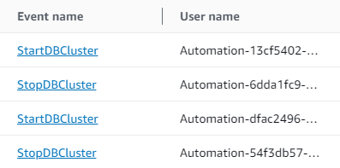
Demo Time
Start and Stop

Slide 7

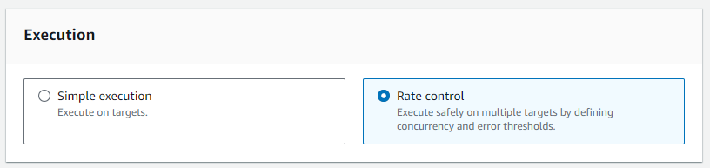
Caveats
Limited cron expressions supported
https://docs.aws.amazon.com/systems-manager/latest/userguide/reference-cron-and-rate-expressions.html#reference-cron-and-rate-expressions-association
AWS::SSM::Association only supports Rate Control executions
Notes:
Of course, this wouldn’t be an AWS service without some things to be aware of
Firstly, support for rich cron expressions is limited, such as multi day windows
This appears to be only for AWS State Manager associations so may change in the future
The CloudFormation API also only supports Rate Control executions for now
To work around this, after the AWS State Manager association is created, change the execution type from Rate Control to Simple within the console
This is a one-time only change and is something in the AWS feature backlog

Slide 8
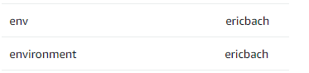
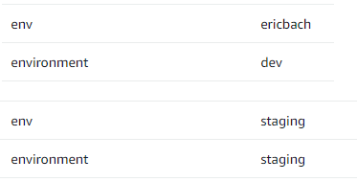
What now?
Review and approve the following PR #<XXX>
Removes existing IaC code using Lambda function to Start/Stop clusters
Sets environment tag to “dev” for all non-staging/prod/security scan environments
Deploy AWS State Manager association
Re-deploy developer F1/M2 environments (without hotswap)
Get CloudOps to remove old Automation scripts (that don’t work)
Notes:
To get this released in our environments, I have PR for you to review
Removes existing Lambda function implementation
Changes the tags for the environment key for all developer environments to dev, the env key still remains as the developer GitHub username
Then we need to deploy the AWS State Manager association
Once each developer re-deploys their F1/M2 developer environments without hotswap it will be all setup
Remove the initial CloudOps implementation with SSM Automation scripts (which don’t work anyways)

Slide 9


Thank you!
Feedback
Questions

